Slide 1
UPPER SIXTH ARTS
GEOGRAPHY
Lesson 8
Agricultural Improvements: The Green Revolution
Notes:
Good morning, class, and welcome to our geography lesson. I am your geography teacher, Mr Kamdem. Today we are starting Lesson 8: Agricultural Improvements: The Green Revolution.

Slide 2
CLASS INFO
Class, Chapter and Duration
Class | Upper Sixth Arts
Chapter | Module 6: Understanding and managing the dynamics of economic activities across the world in general and Cameroon in particular
Duration | 2 periods (2 × 50 minutes)
Notes:
This lesson is for Upper Sixth Arts. It belongs to Module 6: Understanding and managing the dynamics of economic activities across the world in general and Cameroon in particular. We shall need 2 periods to cover it.

Slide 3
IDENTIFICATION
Lesson Identification
Topic | Developments in Agriculture
Sub-topic | Developments in Agriculture
Lesson | Lesson 8: Agricultural Improvements: The Green Revolution
Notions / Concepts | Green Revolution, high-yield varieties, fertiliser, irrigation, pesticides, genetically modified crops.
Syllabus focus | The Green Revolution: meaning, aspects, advantages and disadvantages (LEDCs and MEDCs); the New Green Revolution.
Competence | Learners are able to explain and evaluate the Green Revolution.
Notes:
Our topic is Developments in Agriculture, and the sub-topic is Developments in Agriculture. The key notions we shall use today are: green Revolution, high-yield varieties, fertiliser, irrigation, pesticides, genetically modified crops. At the end, you should be able to do this: learners are able to explain and evaluate the Green Revolution.

Slide 4

HOMEWORK CORRECTION
Correction of the Homework
Question (Lesson 7: Sinclair's Model of Agricultural Land Value):
Observe the edge of your town and say if Sinclair's model applies.
Notes:
Before we start the new lesson, let us correct the homework I gave you at the end of Lesson 7: Sinclair's Model of Agricultural Land Value. The question was: Observe the edge of your town and say if Sinclair's model applies. Take out your exercise books.

Slide 5
HOMEWORK CORRECTION
Correction: Possible Answer
At the edge of town, many plots are bought and left empty or used for short-term crops while waiting for building; this supports Sinclair's urban shadow.
Notes:
Here is a good answer. At the edge of town, many plots are bought and left empty or used for short-term crops while waiting for building; this supports Sinclair's urban shadow. Compare it with your own answer and correct your work in red.

Slide 6
LESSON PLAN
Lesson Plan
Correction of the homework
Objectives and recall
Real-life situation and action to take
Learning activities
Board summary
Evaluation, remediation and homework
Notes:
Here is the plan of our lesson today. First, we shall correct the homework. Then we shall look at the objectives and recall what you already know. After that, we shall study a situation from real life and the action to take, and do the learning activities. Finally, we shall copy the board summary, do the evaluation and the remediation, and I will give you the homework.

Slide 7
OBJECTIVES
Objectives
By the end of this lesson, you should be able to:
Define the Green Revolution.
Describe its aspects and results.
Evaluate its advantages and disadvantages and describe the New Green Revolution.
Notes:
By the end of this lesson, you should be able to do three things. Number 1: define the Green Revolution. Number 2: describe its aspects and results. Number 3: evaluate its advantages and disadvantages and describe the New Green Revolution.

Slide 8
PREVIOUS KNOWLEDGE
Previous Knowledge
Fertiliser and irrigation raise yields.
Asia grows much rice.
Notes:
Let us first remember what you already know. Fertiliser and irrigation raise yields. Asia grows much rice. Keep this in mind, because we shall build on it today.

Slide 9
REAL-LIFE SITUATION
Situation in Real Life
In the 1960s India feared famine. New rice and wheat seeds with fertiliser and irrigation doubled its harvests. Today some Indian farmers are in debt and their soils are polluted.
Notes:
Listen carefully to this situation from real life. In the 1960s India feared famine. New rice and wheat seeds with fertiliser and irrigation doubled its harvests. Today some Indian farmers are in debt and their soils are polluted. Think about it, because I am going to ask you some questions.

Slide 10
REAL-LIFE SITUATION
Situation: Question 1
What is the problem in the situation?
Notes:
Question 1: What is the problem in the situation? Think for a moment, then raise your hand to answer.

Slide 11
REAL-LIFE SITUATION
Answer
New farming methods had good and bad results.
Notes:
Good. New farming methods had good and bad results.

Slide 12
REAL-LIFE SITUATION
Situation: Question 2
What is this change called?
Notes:
Question 2: What is this change called? Think for a moment, then raise your hand to answer.

Slide 13
REAL-LIFE SITUATION
Answer
The Green Revolution.
Notes:
Good. The Green Revolution.

Slide 14
REAL-LIFE SITUATION
Situation: Question 3
Give one bad effect.
Notes:
Question 3: Give one bad effect. Think for a moment, then raise your hand to answer.

Slide 15
REAL-LIFE SITUATION
Possible Answer
Debt or pollution.
Notes:
Good. Debt or pollution.

Slide 16
ACTION TO TAKE
Action to Take
Adopt improved farming techniques while protecting the environment.
Notes:
From this situation, the action we are working towards in this lesson is the following: adopt improved farming techniques while protecting the environment.

Slide 17
JUSTIFICATION
Justification of the Lesson
This lesson helps us to judge modern ways of producing more food.
Notes:
Why is this lesson important for you? This lesson helps us to judge modern ways of producing more food.

Slide 18
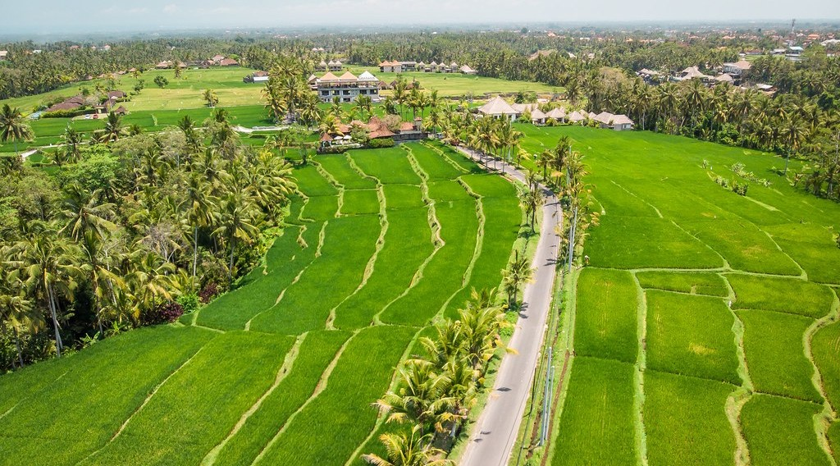
1. MEANING
Activity 1
Rice fields in Asia.
Notes:
Activity 1. Look carefully at this picture: rice fields in Asia. Observe every detail before I ask the question.

Slide 19
1. MEANING
Activity 1: Question
What was the Green Revolution?
Notes:
Here is the question for Activity 1: What was the Green Revolution? Take one minute to think and write your answer in your rough notebook.

Slide 20
1. MEANING
Activity 1: Answer
The use of new high-yield seeds with fertiliser, irrigation and pesticides from the 1960s.
Notes:
Let us check the answer together. The use of new high-yield seeds with fertiliser, irrigation and pesticides from the 1960s.

Slide 21
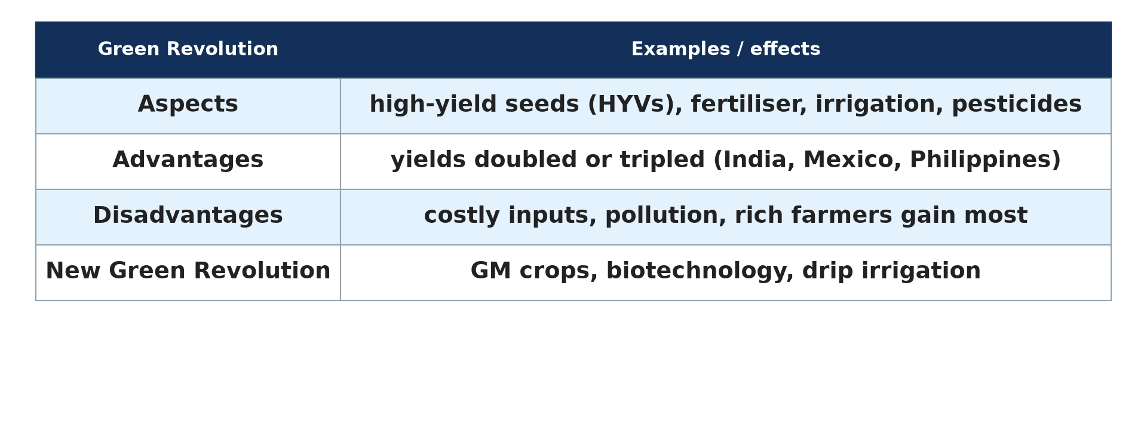
2. ASPECTS
Activity 2
The Green Revolution.
Notes:
Activity 2. Look carefully at this diagram: the Green Revolution. Observe every detail before I ask the question.

Slide 22
2. ASPECTS
Activity 2: Question
Name four inputs of the Green Revolution.
Notes:
Here is the question for Activity 2: Name four inputs of the Green Revolution. Take one minute to think and write your answer in your rough notebook.

Slide 23
2. ASPECTS
Activity 2: Answer
High-yield seeds, fertiliser, irrigation, pesticides.
Notes:
Let us check the answer together. High-yield seeds, fertiliser, irrigation, pesticides.

Slide 24
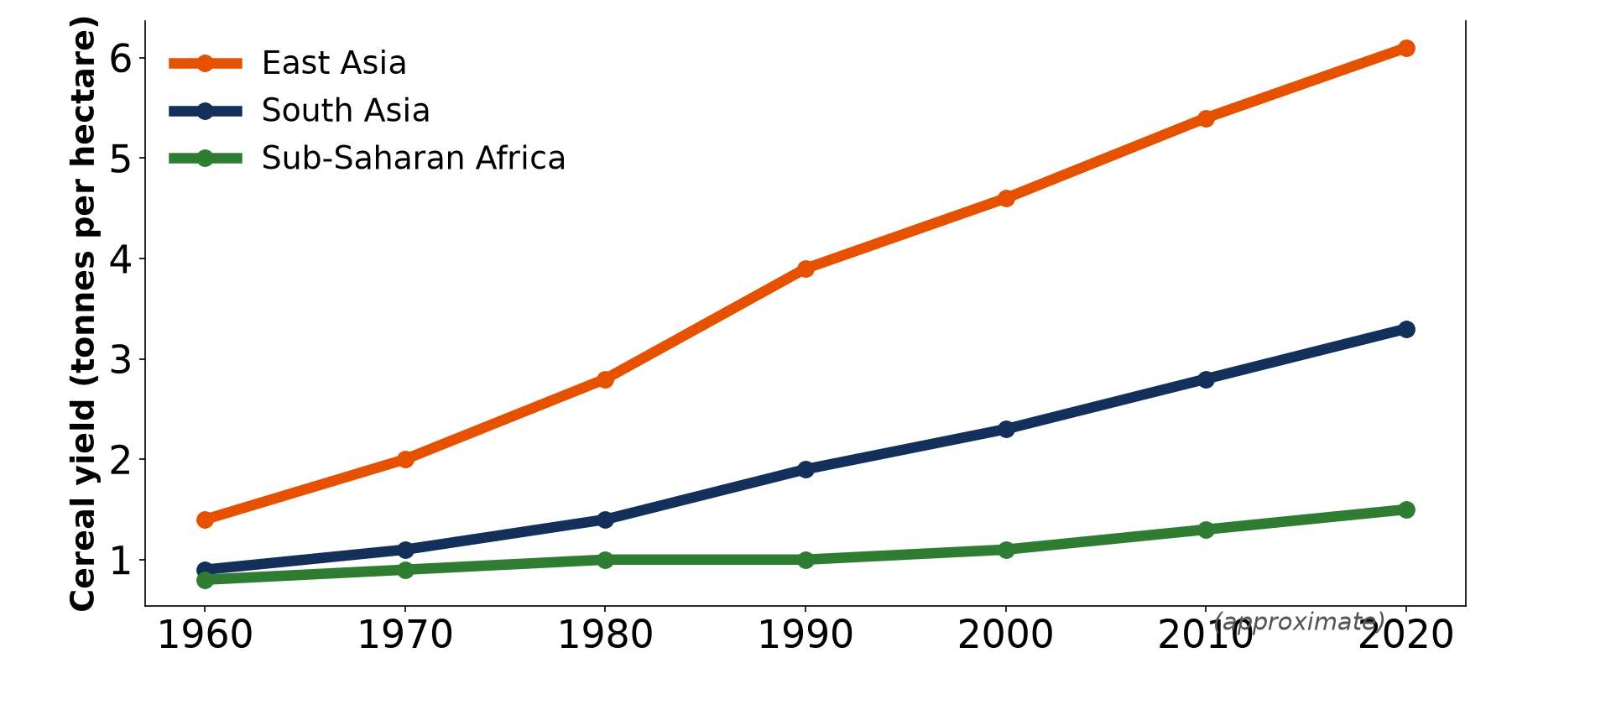
3. ADVANTAGES
Activity 3
Cereal yields by region (approximate).
Notes:
Activity 3. Look carefully at this diagram: cereal yields by region (approximate). Observe every detail before I ask the question.

Slide 25
3. ADVANTAGES
Activity 3: Question
Which region gained most? Which gained least?
Notes:
Here is the question for Activity 3: Which region gained most? Which gained least? Take one minute to think and write your answer in your rough notebook.

Slide 26
3. ADVANTAGES
Activity 3: Answer
East Asia most; Sub-Saharan Africa least.
Notes:
Let us check the answer together. East Asia most; Sub-Saharan Africa least.

Slide 27

4. DISADVANTAGES
Activity 4
Spraying pesticides.
Notes:
Activity 4. Look carefully at this picture: spraying pesticides. Observe every detail before I ask the question.

Slide 28
4. DISADVANTAGES
Activity 4: Question
Give two disadvantages of the Green Revolution.
Notes:
Here is the question for Activity 4: Give two disadvantages of the Green Revolution. Take one minute to think and write your answer in your rough notebook.

Slide 29
4. DISADVANTAGES
Activity 4: Answer
Pollution by chemicals and debt of poor farmers (also water overuse).
Notes:
Let us check the answer together. Pollution by chemicals and debt of poor farmers (also water overuse).

Slide 30

5. THE NEW GREEN REVOLUTION
Activity 5
A field trial of new crops.
Notes:
Activity 5. Look carefully at this picture: a field trial of new crops. Observe every detail before I ask the question.

Slide 31
5. THE NEW GREEN REVOLUTION
Activity 5: Question
What is the New Green Revolution?
Notes:
Here is the question for Activity 5: What is the New Green Revolution? Take one minute to think and write your answer in your rough notebook.

Slide 32
5. THE NEW GREEN REVOLUTION
Activity 5: Answer
The use of biotechnology, GM crops and efficient irrigation to raise yields.
Notes:
Let us check the answer together. The use of biotechnology, GM crops and efficient irrigation to raise yields.

Slide 33
BOARD SUMMARY
Board Summary
Topic: Developments in Agriculture
Sub-topic: Developments in Agriculture
Lesson 8: Agricultural Improvements: The Green Revolution
Notes:
Now we are going to copy the board summary. Write the title and the headings neatly in your notebooks. I will give you enough time for each slide, so do not rush.

Slide 34
BOARD SUMMARY
1. The Green Revolution
The Green Revolution can be studied as follows:
Meaning: It is the great increase in food production from the 1960s, based on new high-yielding varieties (HYVs) of rice, wheat and maize. It began in Mexico, India and the Philippines.
Notes:
Let us copy The Green Revolution. The Green Revolution can be studied as follows. On this slide we have Meaning. Write each point on a new line, with the key term first, and explain it in your own words when we revise. When you finish, we go to the next slide.

Slide 35
BOARD SUMMARY
1. The Green Revolution (continued)
Aspects: HYV seeds were combined with chemical fertilisers, pesticides, irrigation and machines. Governments gave credit and extension services.
Notes:
We continue with The Green Revolution. On this slide we have Aspects. Write each point on a new line, with the key term first, and explain it in your own words when we revise. When you finish, we go to the next slide.

Slide 36
BOARD SUMMARY
1. The Green Revolution (continued)
Advantages: Yields doubled or tripled, famine was avoided in India and farmers' incomes rose. More food became available for growing cities.
Notes:
We continue with The Green Revolution. On this slide we have Advantages. Write each point on a new line, with the key term first, and explain it in your own words when we revise. When you finish, we go to the next slide.

Slide 37
BOARD SUMMARY
1. The Green Revolution (continued)
Disadvantages: Inputs are expensive, so poor farmers fell into debt and rich farmers gained most. Chemicals polluted water and soils, and water tables fell.
Notes:
We continue with The Green Revolution. On this slide we have Disadvantages. Write each point on a new line, with the key term first, and explain it in your own words when we revise.

Slide 38
BOARD SUMMARY
1. The Green Revolution
Illustration: aspects of the Green Revolution
Notes:
Now draw this illustration in your notebook: aspects of the Green Revolution. Give it a title and label it clearly.

Slide 39
BOARD SUMMARY
2. Specific Cases and the New Green Revolution
The results differ and a new revolution has begun:
Cases in LEDCs and MEDCs: Asia gained most, while Sub-Saharan Africa gained little because of poor irrigation and roads. In MEDCs, machines and chemicals had already raised yields.
Notes:
Let us copy Specific Cases and the New Green Revolution. The results differ and a new revolution has begun. On this slide we have Cases in LEDCs and MEDCs. Write each point on a new line, with the key term first, and explain it in your own words when we revise. When you finish, we go to the next slide.

Slide 40
BOARD SUMMARY
2. Specific Cases and the New Green Revolution (continued)
The New Green Revolution: It uses biotechnology, genetically modified (GM) crops, drip irrigation and precision farming. It aims at higher yields with less water and fewer chemicals, but GM crops are debated.
Notes:
We continue with Specific Cases and the New Green Revolution. On this slide we have The New Green Revolution. Write each point on a new line, with the key term first, and explain it in your own words when we revise.

Slide 41
BOARD SUMMARY
2. Specific Cases and the New Green Revolution
Illustration: cereal yields by region
Notes:
Now draw this illustration in your notebook: cereal yields by region. Give it a title and label it clearly.

Slide 42
FORMATIVE EVALUATION
Evaluation 1
Give two advantages and two disadvantages of the Green Revolution.
Notes:
Now let us check what you have understood. Question 1: Give two advantages and two disadvantages of the Green Revolution. Answer in your exercise book.

Slide 43
FORMATIVE EVALUATION
Expected Answer
Advantages: higher yields, less famine. Disadvantages: pollution, debt.
Notes:
The expected answer is: advantages: higher yields, less famine. Disadvantages: pollution, debt. If you got it right, well done.

Slide 44
FORMATIVE EVALUATION
Evaluation 2
Why did Africa gain little from the Green Revolution?
Notes:
Now let us check what you have understood. Question 2: Why did Africa gain little from the Green Revolution? Answer in your exercise book.

Slide 45
FORMATIVE EVALUATION
Expected Answer
Little irrigation, poor roads and costly inputs.
Notes:
The expected answer is: little irrigation, poor roads and costly inputs. If you got it right, well done.

Slide 46
REMEDIATION
Remediation
Fill in the blanks:
New seeds with high yields are ______.
The Green Revolution began in the ______.
Changed genes make ______ crops.
Notes:
For those who need more practice, fill in the blanks in your exercise book. The answers are: number 1, HYVs; number 2, 1960s; number 3, GM.

Slide 47
HOMEWORK
Homework
Ask a farmer if he uses improved seeds and fertiliser and what results he gets.
Notes:
For your homework: Ask a farmer if he uses improved seeds and fertiliser and what results he gets. We shall correct it at the beginning of our next lesson.

Slide 48
NEXT LESSON
Next Lesson
Our next lesson will be on:
Lesson 9: Meeting the Increasing Food Demand
Notes:
Our next lesson will be on Lesson 9: Meeting the Increasing Food Demand. Thank you for your attention, and see you next time.

Slide 49
BILINGUAL GAME
Bilingual Game (Jeu Bilingue)
English | Français
Green Revolution | La révolution verte
Seed | La semence
Fertiliser | L'engrais
Pesticide | Le pesticide
Irrigation | L'irrigation
Debt | L'endettement
Notes:
Let us play the bilingual game. I say a word in English, and you give me the French word. Then we do the reverse.

Slide 50
LOGBOOK
Official Logbook (1/2)
Module / Topic | Developments in Agriculture
Lesson Title | Lesson 8: Agricultural Improvements: The Green Revolution
Expected Learning Outcomes | Define the Green Revolution. Describe its aspects and results. Evaluate its advantages and disadvantages and describe the New Green Revolution.
Competence | Learners are able to explain and evaluate the Green Revolution.
Notes:
I record this information in the official logbook of the class after the lesson.

Slide 51
LOGBOOK
Official Logbook (2/2)
Matter Taught | The Green Revolution; Specific Cases and the New Green Revolution.
Evaluation | Formative evaluation and remediation exercise.
Homework | Ask a farmer if he uses improved seeds and fertiliser and what results he gets.
Enrolment / Present / Absent | ____ / ____ / ____
Achievement | To be completed after the lesson.
Notes:
I complete the second page of the logbook: the matter taught, the evaluation, the homework and the attendance.

Slide 52
TEACHER'S NOTE
Teacher's Note
Timing: Homework correction, plan, objectives 8 min | Recall, situation, action 10 min | 5 activities 30 min | Board summary (copying) 30 min | Evaluation, remediation 10 min | Homework, next lesson 5 min | Logbook 7 min
Without the projector (Activity 1): find India and Mexico.
Without the projector (Activity 2): copy the table.
Without the projector (Activity 3): read the graph.
Without the projector (Activity 4): discuss chemicals.
Without the projector (Activity 5): discuss new varieties.
Notes:
This slide is for me, the teacher: it gives the timing of the lesson and what to do if the projector is not available.

Slide 53
REFERENCES
References
National Geography Syllabus, MINESEC/IGE/IP-SS, 2019 — Module 6 (Economic Geography).
Photo, Activity 1: “Drone view of rice plantation on bali island with path to walk around ” by Artem Beliaikin, CC0 1.0, via Flickr (https://www.flickr.com/photos/157635012@N07/46229046541)
Photo, Activity 4: “k4817-4” by USDAgov, CC BY 2.0, via Flickr (https://www.flickr.com/photos/41284017@N08/8497812386)
Photo, Activity 5: “CIMMYT international wheat nurseries growing in Ecuador” by CIMMYT, CC BY-NC-SA 2.0, via Flickr (https://www.flickr.com/photos/44760652@N05/5958068839)
Diagrams and animations: drawn for this lesson (Geography Department).
Notes:
These are the references and picture credits used to prepare this lesson.

